Slide 1
Watermark Attacks in AI
Done by: Arun polson, Husnain Ali & VardaAn Kapania

Slide 2
Description
This project uses a deep learning model (U-Net architecture) built with PyTorch to automatically remove watermarks from images. The model is trained on pairs of watermarked and clean images and can process all images in a directory. Github: https://github.com/Orange-V05/Watermark-Removal

Slide 3


Roles
Investigation/Research On Watermark Removal & Documentation
Building an Artificial Intelligence model for Automated Watermark Removal
Training the AI Model for Automated Watermark Removal
HUSNAIN ALI
VARDAAN
ARUN

Slide 4
AI Watermark Removal WEBSITES
TopMediai
Technology: Employs CNN-based Autoencoders or light U-Net architecture for automatic watermark detection and removal.
03
WatermarkRemover.io (by Novita AI)
Technology: Uses AI with U-Net or GAN-based inpainting (e.g., LaMa, DeepFill) to remove text, logos, and date stamps.
01
AniEraser (by Wondershare / Media.io)
Technology: Applies Contextual Attention GAN or EdgeConnect for removing watermarks in both images and videos.
02

Slide 5
AI Watermark Removal WEBSITES
PicWish (by Apowersoft)
Technology: Utilizes deep learning inpainting via encoder-decoder networks for seamless watermark removal.
04
AI Ease
Technology:
Combines GANs with segmentation models for layer-aware detection and removal of watermarks.
05
06
AirBrush Video Remover
Technology: Uses frame-wise CNNs with temporal smoothing to remove watermarks from video content.

Slide 6


Building AI MODEL

Slide 7

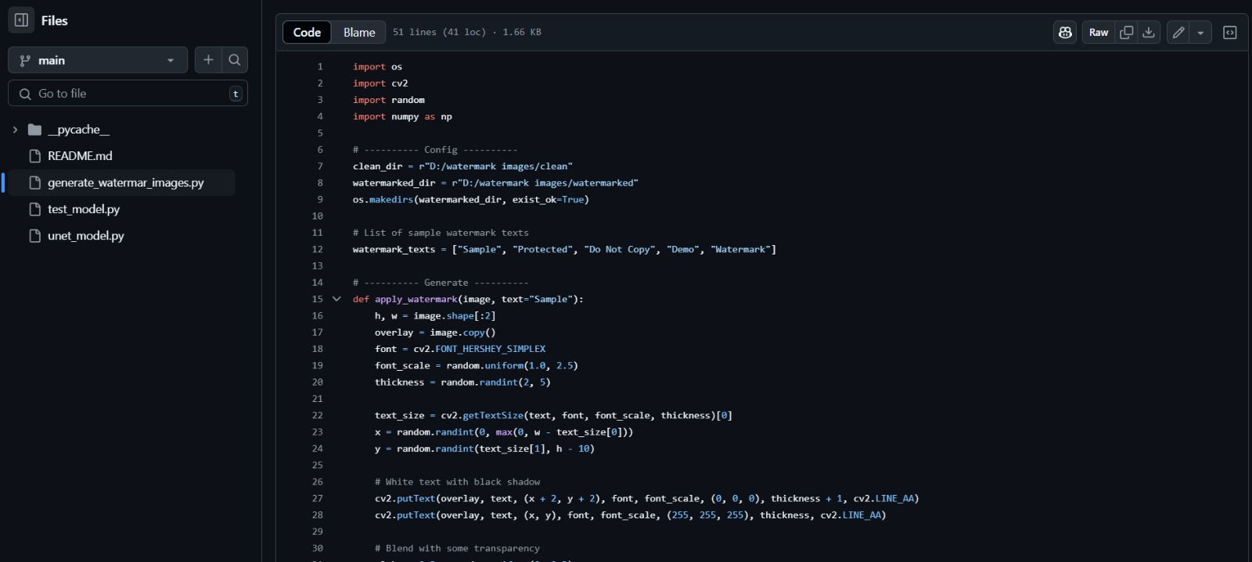
Building AI MODEL

Slide 8

Training AI Model

Slide 9


Output

Slide 10
ML Security Issue | Relevance to Watermark AI
1. Data Poisoning | Watermarks can help track poisoned inputs or assert ownership of training data to detect unauthorized data reuse.
2. Model Inversion | If an attacker reconstructs training data, watermarking can prove original ownership or detect leaks.
3. Model Extraction (Stealing) | Watermarked models can "call home" (e.g., produce a specific output on a trigger input), revealing theft.
4. Adversarial Examples | Watermarks in training can help models detect tampered inputs or flag manipulated outputs.
5. Membership Inference | Watermarking training data could help identify whether a specific data sample was leaked or overfit.
6. Model Evasion | Embedded watermarks might help detect suspicious usage patterns aiming to bypass AI systems.
7. Insider Threats | Watermarks can track which internal user accessed or used specific models or outputs.
8. Lack of Model Transparency | Watermarks can act as audit trails, helping explain where and how AI outputs originated.
9. Unsecure Third-Party Components | Watermarked models can help detect if an AI provider’s model has been tampered with or replaced.
10. Lack of Monitoring and Logging | Watermarking outputs adds an invisible layer of monitoring, enabling forensic analysis.
How watermark AI ties into the common Top 10 Machine Learning Security issues

Slide 11
THANK YOU

